Slide 1

Wordle ‘Project’ {
Wordle.c
ECE-131L
[For ECE-131L]
< By: Nathan Risenhoover, Miles Nakai, Simon Padilla, Gray Sherwood and Matthew Sauceda >
}
4/28/2026 - ECE-131L-003 – Group 5

Slide 2
01 {
[What is this Program?]
Wordle.c
ECE-131L
< Recreation of Wordle in C >
< Designed for casual players, and beginner programmers >
< Simple, additional features such as game history >
}
4/28/2026 - ECE-131L-003 – Group 5

Slide 3

< What is Wordle? > {
Wordle.c
ECE-131L
< A game where users must guess a five-letter word. Users are given feedback from their guesses based on color to figure out which letters are in the mystery word, and what the position of each letter is. >
}
< Unique Functionality > {
< Add extra words to word library >
< View the history of prior games played >
< Remove game history on command >
}
4/28/2026 - ECE-131L-003 – Group 5

Slide 4
02 {
[Program Design]
Wordle.c
ECE-131L
< Text files for word library, and game history >
< Structures, string handling >
< Loops for comparison logic, preventing edge cases >
}
4/28/2026 - ECE-131L-003 – Group 5

Slide 5
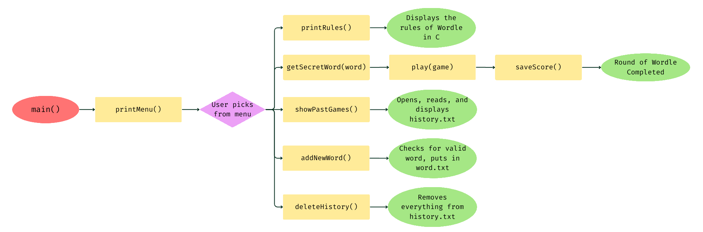
Program Design{
Wordle.c
ECE-131L
< Function Flowchart >
}
4/28/2026 - ECE-131L-003 – Group 5

Slide 6
03 {
[DEMO]
Wordle.c
ECE-131L
< Scenario 1: Game played >
< Scenario 2: Adding a word to the library >
< Scenario 3: Edge case >
}
4/28/2026 - ECE-131L-003 – Group 5

Slide 7
04 {
[Lessons Learned]
Wordle.c
ECE-131L
< Repeated letter bug >
< Repeat words in word library >
}
4/28/2026 - ECE-131L-003 – Group 5

Slide 8
< How we Fixed the bugs > {
Wordle.c
ECE-131L
< Modified for loops to track letters that have already been matched >
< Added a loop which scans all strings in the word library, and compares the user input string to all strings in library >
}
< What to improve > {
< Program modularity and edge case handling >
< More input validation, specifically of the words that the user enters >
< User friendliness, clearer formatting >
}
4/28/2026 - ECE-131L-003 – Group 5

Slide 9
Thank you; {
Wordle.c
ECE-131L
‘Questions?’
Please ask away! :)
}
4/28/2026 - ECE-131L-003 – Group 5

